Slide 1
Review of Elementary Acid – Base Chemistry:
Extension and Application of the Concepts to Organic Reactivity
For 2nd and 3rd Year Organic and Biochemistry Students
David Morgan
NDSU Department of Chemistry and Biochemistry
Fargo, ND USA

Slide 2
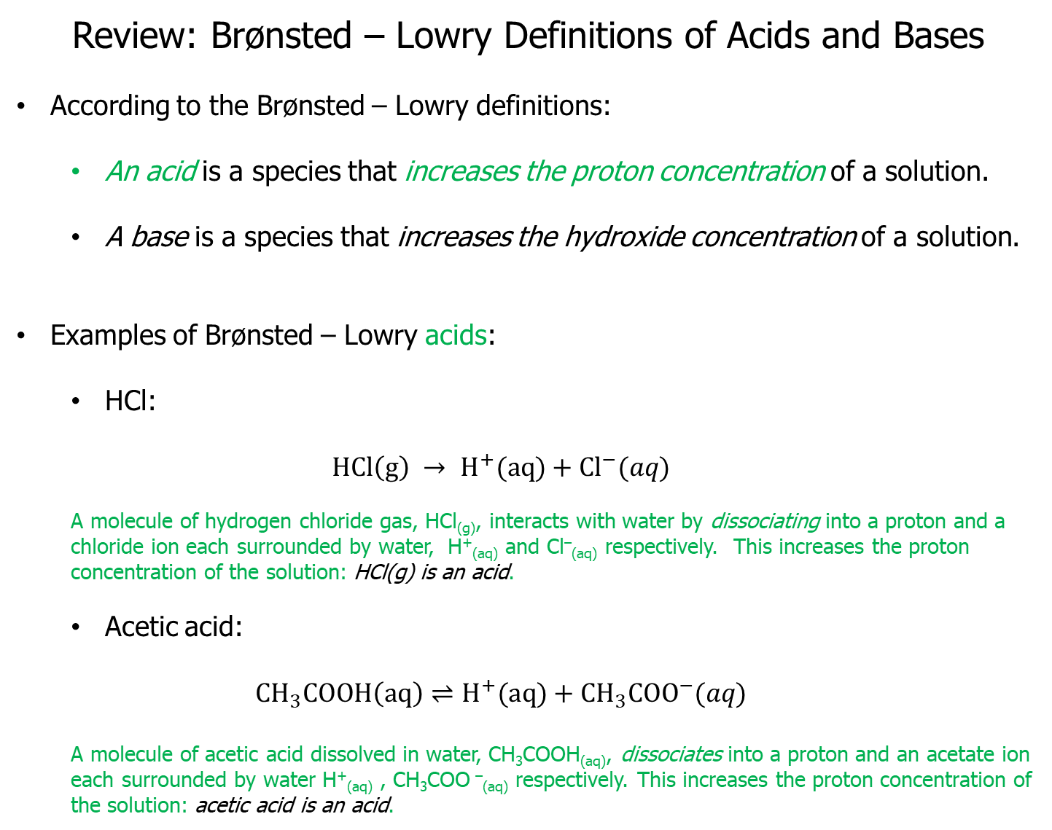
Review: Brønsted – Lowry Definitions of Acids and Bases
According to the Brønsted – Lowry definitions:
An acid is a species that increases the proton concentration of a solution.
A base is a species that increases the hydroxide concentration of a solution.
Examples of Brønsted – Lowry acids:
HCl:
$$HCl\left(g\right) → H^{+}(aq)+{Cl}^{−}(aq)$$
A molecule of hydrogen chloride gas, HCl_{(g)}, interacts with water by dissociating into a proton and a chloride ion each surrounded by water, H⁺_{(aq)} and Cl–_{(aq)} respectively. This increases the proton concentration of the solution: HCl(g) is an acid.
Acetic acid:
$$CH_{3}COOH\left(aq\right)⇌H^{+}(aq)+{CH_{3}COO}^{−}(aq)$$
A molecule of acetic acid dissolved in water, CH₃COOH_{(aq)}, dissociates into a proton and an acetate ion each surrounded by water H⁺_{(aq)} , CH₃COO –_{(aq)} respectively. This increases the proton concentration of the solution: acetic acid is an acid.
H₂O

Slide 3
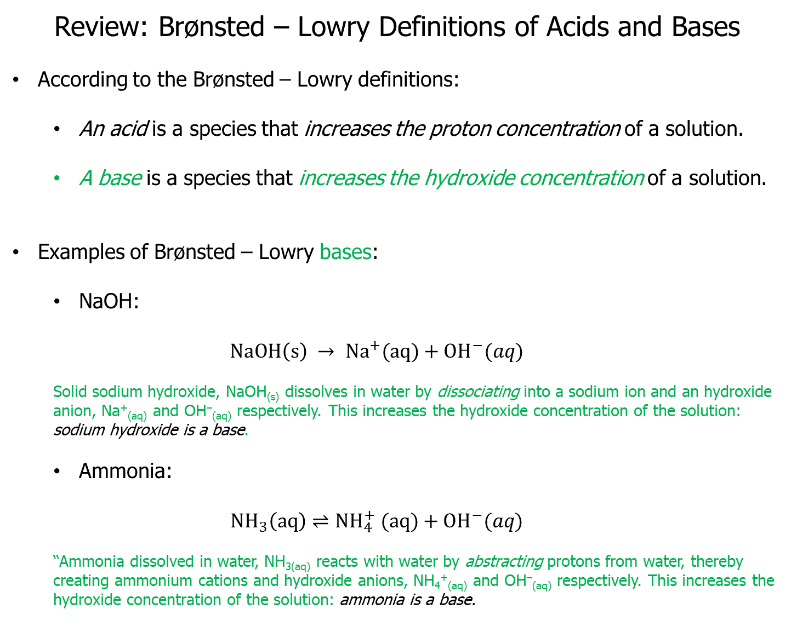
Review: Brønsted – Lowry Definitions of Acids and Bases
According to the Brønsted – Lowry definitions:
An acid is a species that increases the proton concentration of a solution.
A base is a species that increases the hydroxide concentration of a solution.
Examples of Brønsted – Lowry bases:
NaOH:
$$NaOH\left(s\right) → {Na}^{+}(aq)+{OH}^{−}(aq)$$
Solid sodium hydroxide, NaOH_{(s)} dissolves in water by dissociating into a sodium ion and an hydroxide anion, Na⁺_{(aq)} and OH–_{(aq)} respectively. This increases the hydroxide concentration of the solution: sodium hydroxide is a base.
Ammonia:
$$NH_{3}\left(aq\right)⇌{NH}_{4}^{+} (aq)+{OH}^{−}(aq)$$
“Ammonia dissolved in water, NH_{3(aq)} reacts with water by abstracting protons from water, thereby creating ammonium cations and hydroxide anions, NH₄⁺_{(aq)} and OH–_{(aq)} respectively. This increases the hydroxide concentration of the solution: ammonia is a base.
H₂O
H₂O

Slide 4
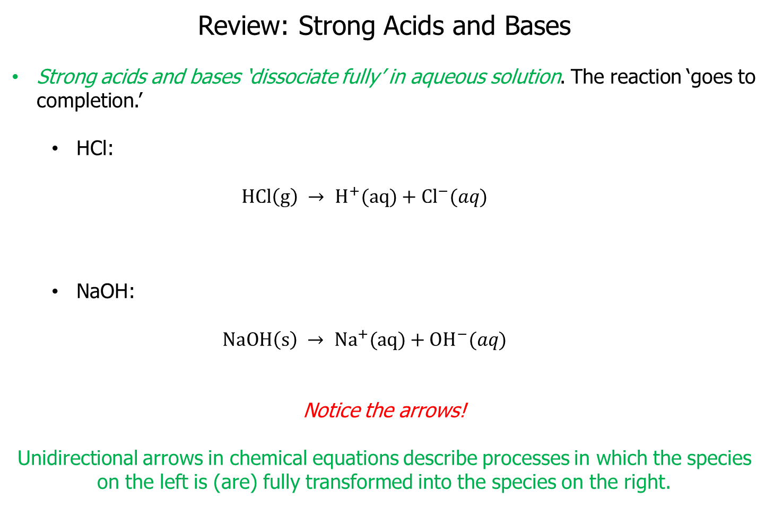
Review: Strong Acids and Bases
Strong acids and bases ‘dissociate fully’ in aqueous solution. The reaction ‘goes to completion.’
HCl:
$$HCl\left(g\right) → H^{+}(aq)+{Cl}^{−}(aq)$$
NaOH:
$$NaOH\left(s\right) → {Na}^{+}(aq)+{OH}^{−}(aq)$$
Notice the arrows!
Unidirectional arrows in chemical equations describe processes in which the species on the left is (are) fully transformed into the species on the right.
H₂O
H₂O

Slide 5
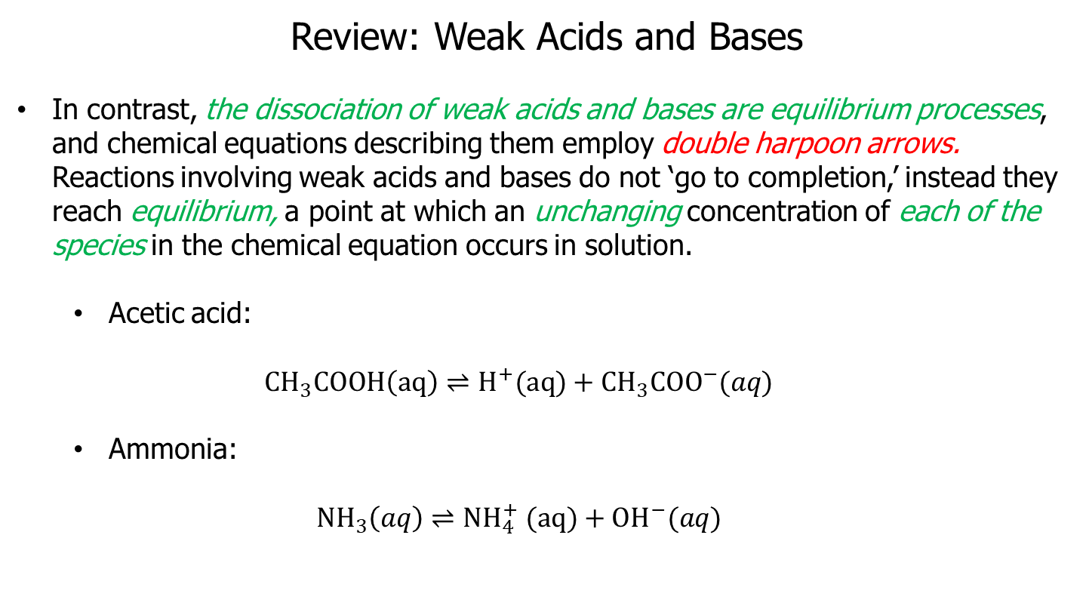
Review: Weak Acids and Bases
In contrast, the dissociation of weak acids and bases are equilibrium processes, and chemical equations describing them employ double harpoon arrows. Reactions involving weak acids and bases do not ‘go to completion,’ instead they reach equilibrium, a point at which an unchanging concentration of each of the species in the chemical equation occurs in solution.
Acetic acid:
$$CH_{3}COOH\left(aq\right)⇌H^{+}(aq)+{CH_{3}COO}^{−}(aq)$$
Ammonia:
$$NH_{3}\left(aq\right)⇌{NH}_{4}^{+} (aq)+{OH}^{−}(aq)$$
H₂O
Notice the double harpoon arrows!

Slide 6
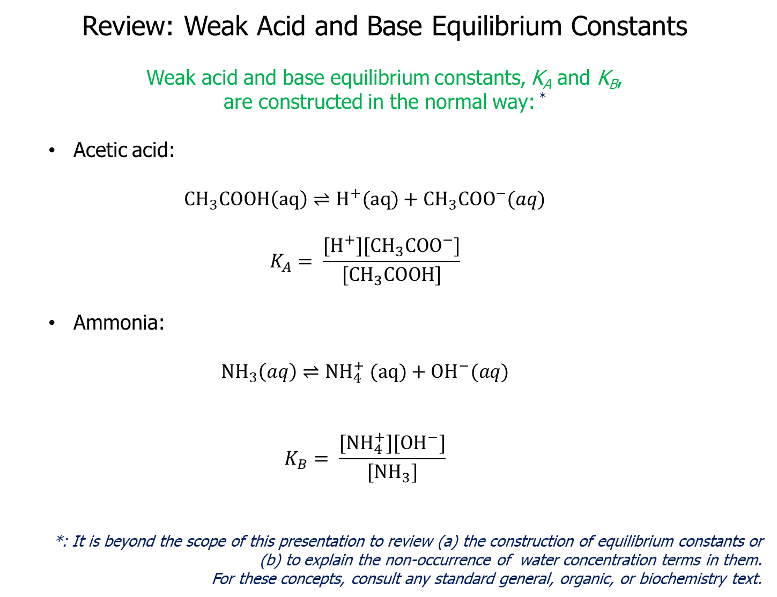
Review: Weak Acid and Base Equilibrium Constants
Weak acid and base equilibrium constants, K_{A} and K_{B},
are constructed in the normal way: *
Acetic acid:
$$CH_{3}COOH\left(aq\right)⇌H^{+}(aq)+{CH_{3}COO}^{−}(aq)$$
$$K_{A}= \frac{[H^{+}][{CH_{3}COO}^{−}]}{[CH_{3}COOH]}$$
Ammonia:
$$NH_{3}\left(aq\right)⇌{NH}_{4}^{+} (aq)+{OH}^{−}(aq)$$
$$K_{B}= \frac{[{NH}_{4}^{+}][{OH}^{−}]}{[NH_{3}]}$$
*: It is beyond the scope of this presentation to review (a) the construction of equilibrium constants or (b) to explain the non-occurrence of water concentration terms in them.
For these concepts, consult any standard general, organic, or biochemistry text.

Slide 7
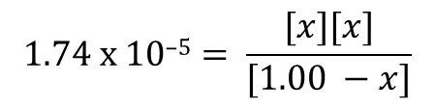
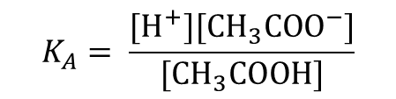
Equilibrium Constants Facilitate the Determination of Equilibrium Concentrations (I)
Suppose that for acetic acid, K_{A} = 1.74 x 10^{–5}. If a solution is prepared such that 1.00 mol / L of acetic acid is dissolved in 1.00 L of water, determine the equilibrium concentrations of acetic acid (CH₃COOH), protons (H⁺) and acetate anions (CH3COO–).
Substituting the equilibrium constant and equilibrium concentrations, into algebraic expression for the equilibrium constant provides:
$$K_{A}= \frac{[H^{+}][{CH_{3}COO}^{−}]}{[CH_{3}COOH]}$$
$$\text{1.74 }\text{x}\text{ 10–5}= \frac{[x][x]}{[1.00 −x]}$$

Slide 8
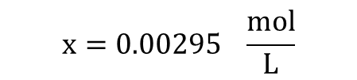
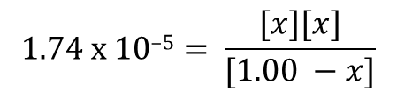
Equilibrium Constants Facilitate the Determination of Equilibrium Concentrations (II)
The above is a quadratic equation and the value of x may be computed as the positive root of the equation using the quadratic formula; negative roots (corresponding to negative concentrations) are meaningless.
The quadratic formula provides:
Substituting this value back into the ‘Equilibrium Concentrations’ equations from the previous table allows computation of the equilibrium concentrations of protons, acetic acid molecules, and acetate anions. These are, respectively, 0.00295 mol/L, 0.997 mol/L, and 0.00295 mol/L.
Note to students: if you do not know the quadratic formula or how to use it, learn it!
If you need help – come see me.
$$\text{1.74 }\text{x}\text{ 10–5}= \frac{[x][x]}{[1.00 −x]}$$
$$\text{x}=0.00295 \frac{mol}{L}$$

Slide 9

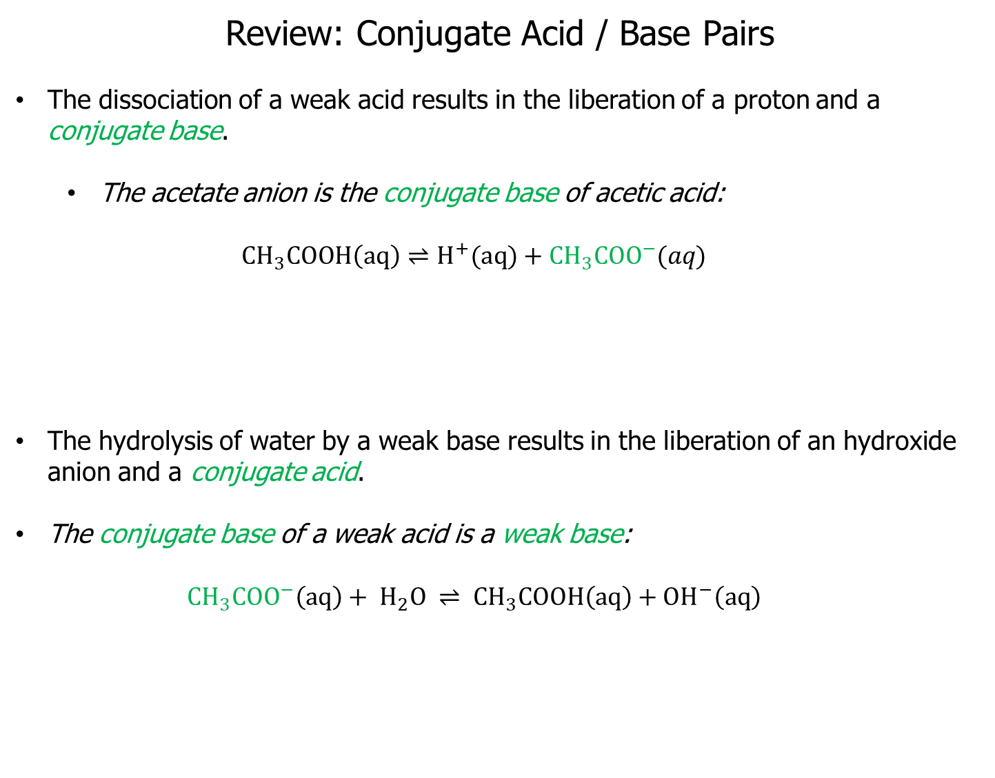

Review: Conjugate Acid / Base Pairs
The dissociation of a weak acid results in the liberation of a proton and a conjugate base.
The acetate anion is the conjugate base of acetic acid:
$$CH_{3}COOH\left(aq\right)⇌H^{+}(aq)+{CH_{3}COO}^{−}(aq)$$
The hydrolysis of water by a weak base results in the liberation of an hydroxide anion and a conjugate acid.
The conjugate base of a weak acid is a weak base:
$${{CH}_{3}COO}^{−}\left(aq\right)+ H_{2}O ⇌{ CH}_{3}COOH\left(aq\right)+{OH}^{−}\left(aq\right)$$
$$K_{A}= \frac{[H^{+}][{CH_{3}COO}^{−}]}{[CH_{3}COOH]}$$
$$K_{B}= \frac{[{ CH}_{3}COOH][{OH}^{−}]}{[{{CH}_{3}COO}^{−}]}$$

Slide 10
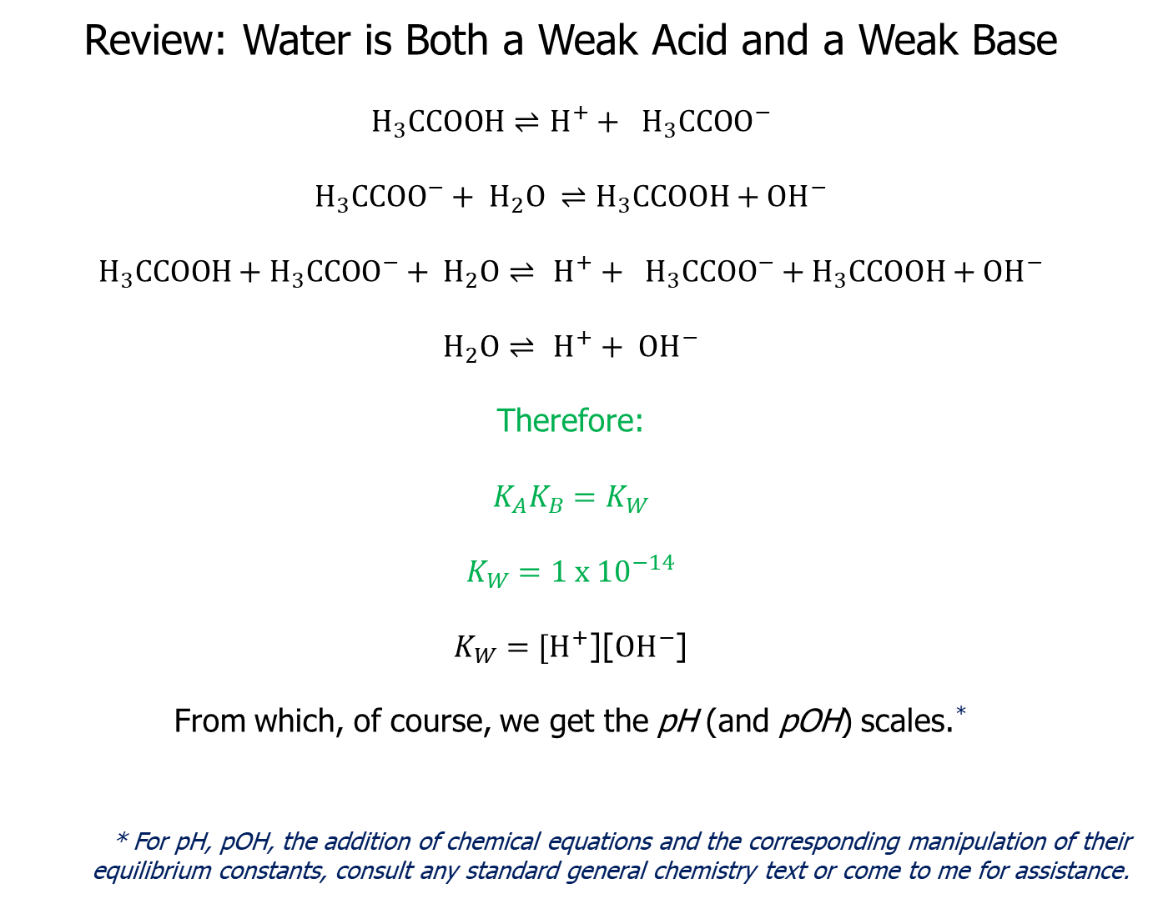
Review: Water is Both a Weak Acid and a Weak Base
$H_{3}CCOOH⇌$ $H^{+}+ {H_{3}CCOO}^{−}$
$${H_{3}CCOO}^{−}+ H_{2}O ⇌H_{3}CCOOH+{OH}^{−}$$
$$H_{3}CCOOH+{H_{3}CCOO}^{−}+ H_{2}O⇌ H^{+}+ {H_{3}CCOO}^{−}+H_{3}CCOOH+{OH}^{−}$$
$$H_{2}O⇌ H^{+}+ {OH}^{−}$$
Therefore:
$$K_{A}K_{B}=K_{W}$$
$$K_{W}=1 x {10}^{−14}$$
$K_{W}=[H^{+}$][${OH}^{−}$]
From which, of course, we get the pH (and pOH) scales.*
* For pH, pOH, the addition of chemical equations and the corresponding manipulation of their equilibrium constants, consult any standard general chemistry text or come to me for assistance.

Slide 11

Review: The Reaction of a Weak Acid with a Base
Generates a Salt and Water
$CH_{3}COOH(aq)+NaOH(aq)⇌$ $CH_{3}COONa(aq) + H_{2}O$

Slide 12
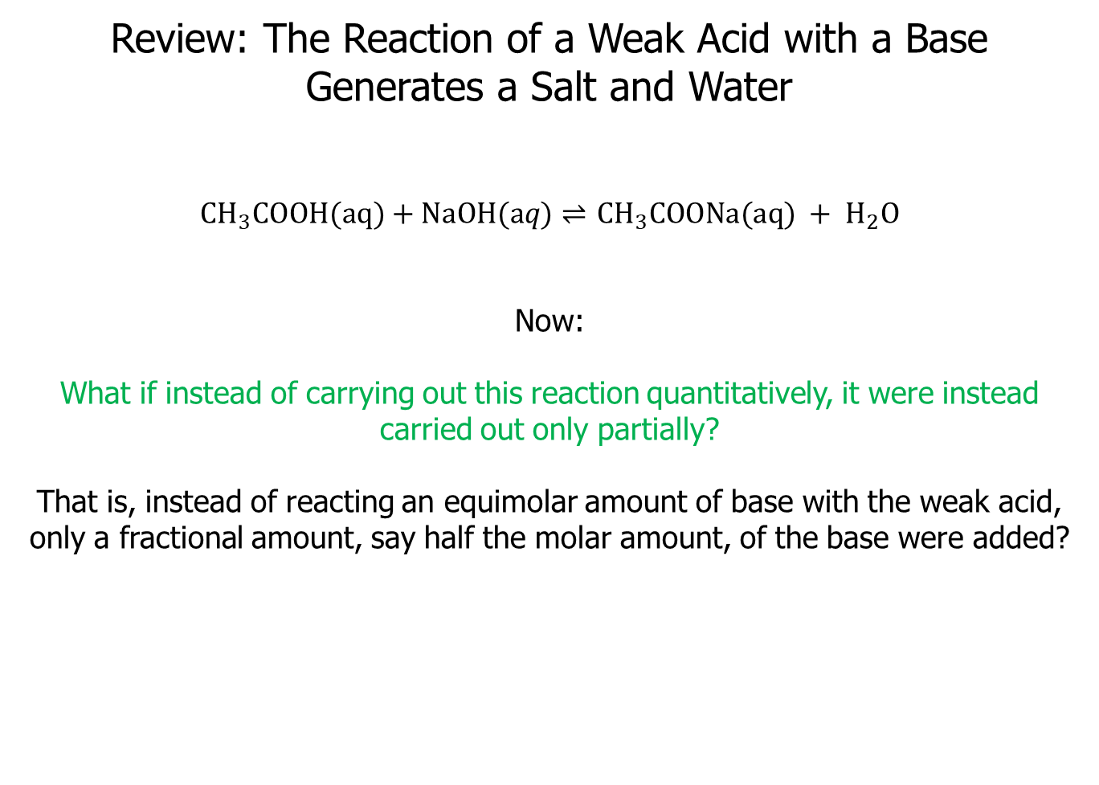
Review: The Reaction of a Weak Acid with a Base
Generates a Salt and Water
$CH_{3}COOH(aq)+NaOH(aq)⇌$ $CH_{3}COONa(aq) + H_{2}O$
Now:
What if instead of carrying out this reaction quantitatively, it were instead carried out only partially?
That is, instead of reacting an equimolar amount of base with the weak acid, only a fractional amount, say half the molar amount, of the base were added?

Slide 13
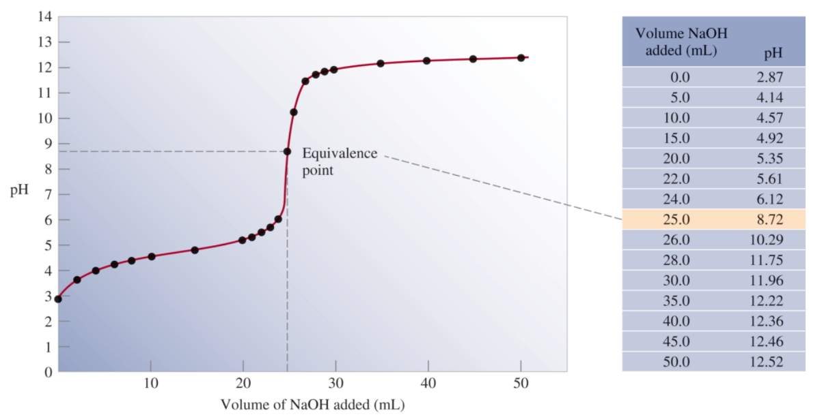
Titration of a Weak Acid by a Strong Base
Note: the gradual change in pH as a function of base added.
At each point in the titration (before the equivalence point) the solution consists of a mixture of acid and conjugate base forms. This kind of mixture is a buffer.

Slide 14
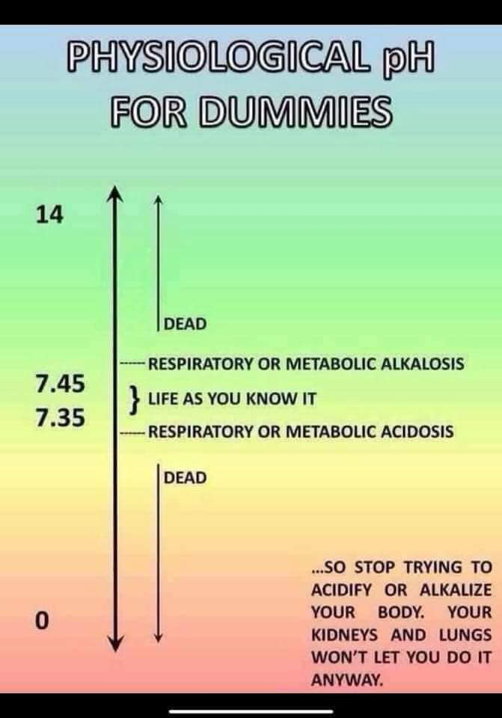
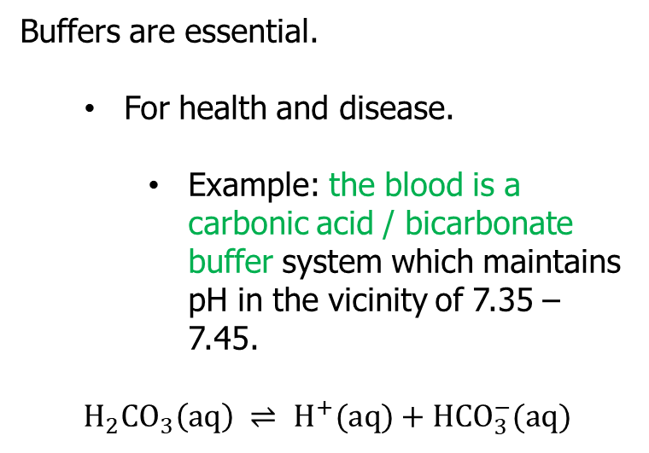
Buffers: Solutions Which are Mixtures of Acid (or base) and Conjugate Base (or acid) Forms
Buffers resist changes in pH.
Buffers are essential.
For health and disease.
Example: the blood is a carbonic acid / bicarbonate buffer system which maintains pH in the vicinity of 7.35 – 7.45.
$$H_{2}CO_{3}\left(aq\right) ⇌ H^{+}(aq)+HCO_{3}^{−}(aq)$$

Slide 15
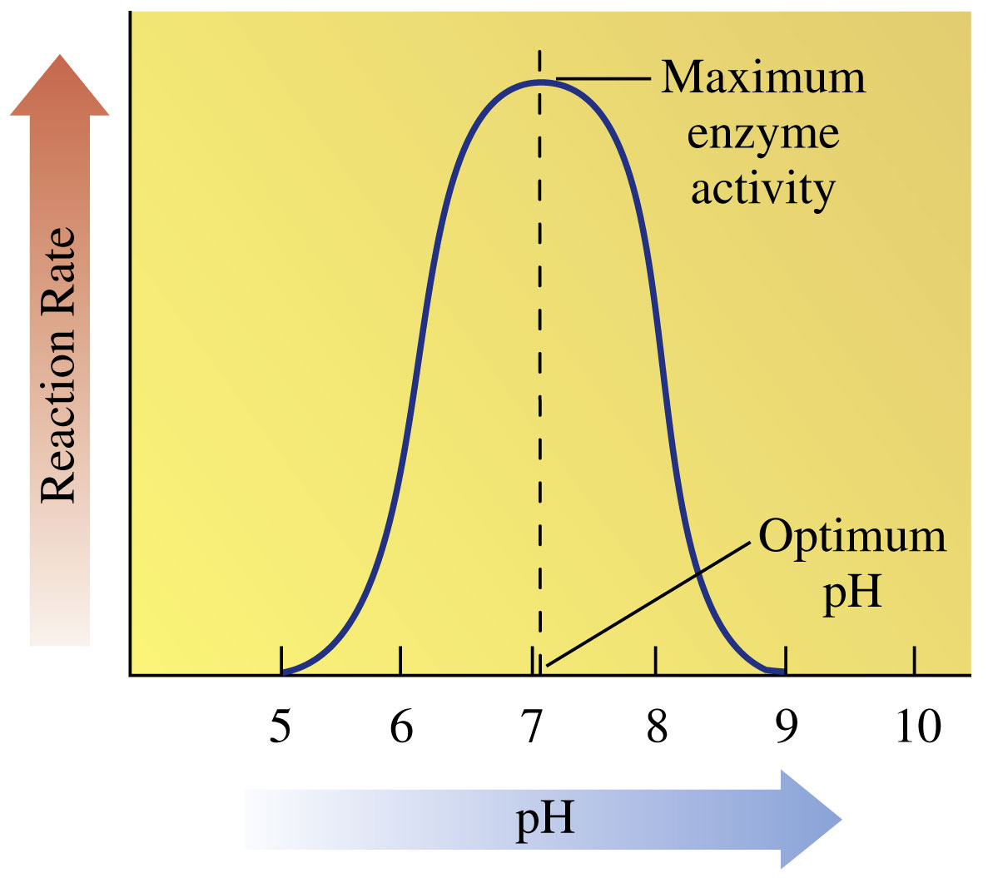
Why Are Buffers Important in Biochemistry?
pH Affects Enzymatic Activity:
Much of enzymatic catalysis involves weak acid / weak base chemistry.
In other words, proton transfers play a big role in enzymatic catalysis.
Therefore, pH dramatically affects enzymatic activity.
Almost all enzymes only carry out their reactions in a narrow range of pH.
Can anyone think of another
reason it is preferable to study
proteins in buffered solutions?
© 2018 Pearson Education, Inc.
Notes:
Figure 16-14 Enzymes are most active at their optimum pH. At a higher or lower pH, denaturation of the enzyme causes a loss of catalytic activity.

Slide 16
Why Are Buffers Important in Biochemistry?
pH Affects Enzymatic Activity:
Much of enzymatic catalysis involves weak acid / weak base chemistry.
In other words, proton transfers play a big role in enzymatic catalysis.
Therefore, pH dramatically affects enzymatic activity.
Almost all enzymes only carry out their reactions in a narrow range of pH.
Can anyone think of another
reason it is preferable to study
proteins in buffered solutions?
Proteins are built of amino acids which themselves contain acidic and basic groups.
The acid-base chemistry of amino acid side chains would disrupt the pH of unbuffered protein solutions.
© 2018 Pearson Education, Inc.
Notes:
Figure 16-14 Enzymes are most active at their optimum pH. At a higher or lower pH, denaturation of the enzyme causes a loss of catalytic activity.

Slide 17
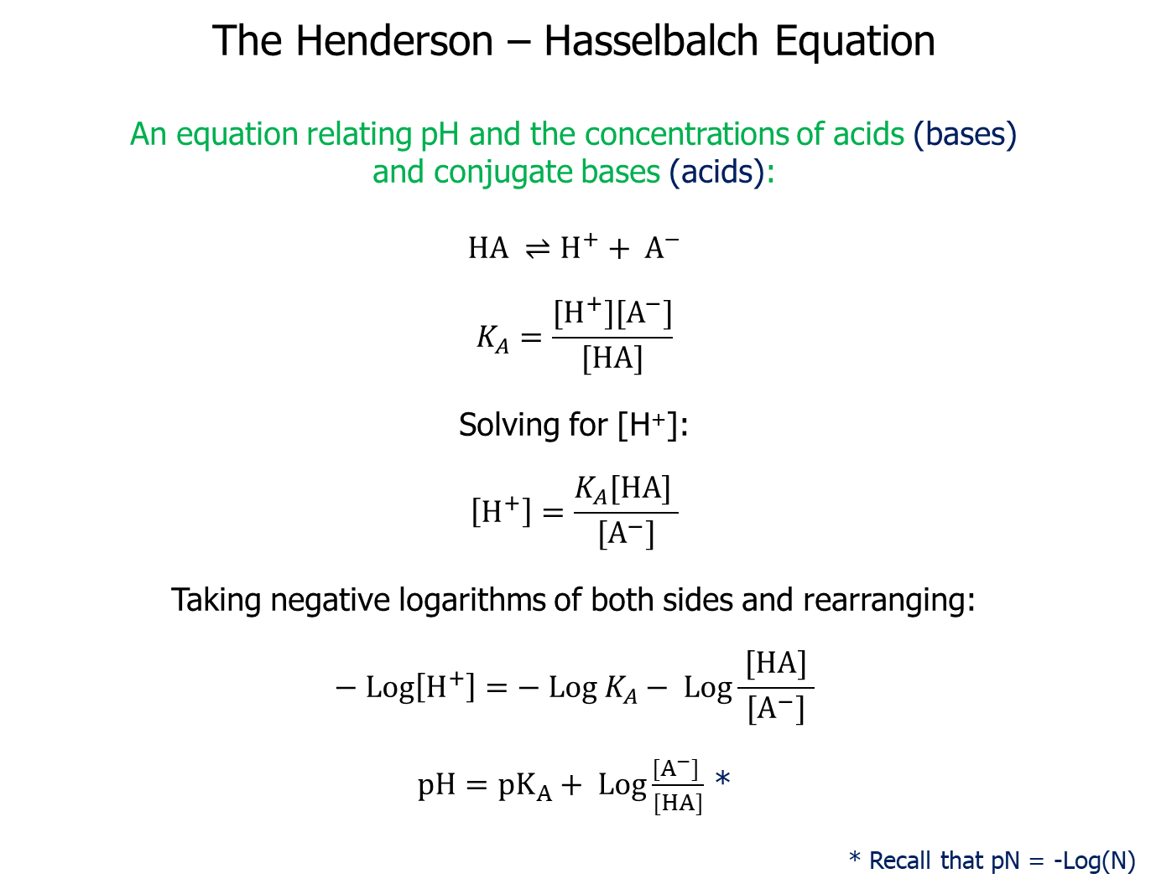
The Henderson – Hasselbalch Equation
An equation relating pH and the concentrations of acids (bases)
and conjugate bases (acids):
$$HA ⇌H^{+}+ A^{−}$$
$$K_{A}=\frac{[H^{+}][A^{−}]}{[HA]}$$
Solving for [H⁺]:
$$\left[H^{+}\right]=\frac{K_{A}[HA] }{[A^{−}]}$$
Taking negative logarithms of both sides and rearranging:
$$− Log\left[H^{+}\right]=− Log{ K}_{A}− Log\frac{ [HA] }{[A^{−}]}$$
$pH=pK_{A}+ Log\frac{[A^{−}] }{[HA]}$ *
* Recall that pN = -Log(N)

Slide 18
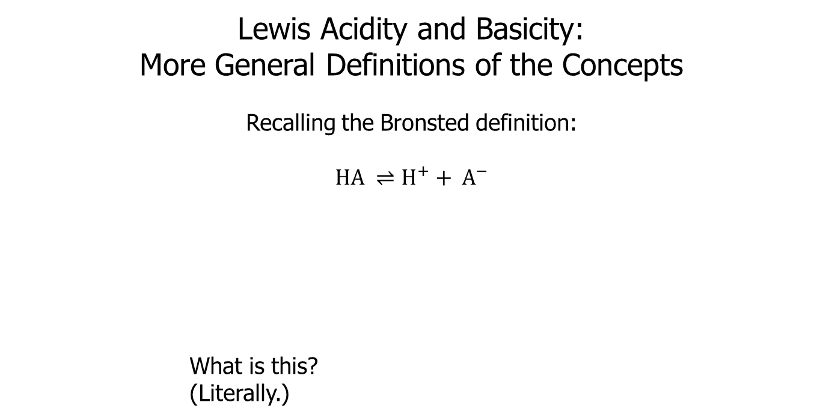
Lewis Acidity and Basicity:
More General Definitions of the Concepts
Recalling the Bronsted definition:
$$HA ⇌H^{+}+ A^{−}$$
What is this?
(Literally.)

Slide 19
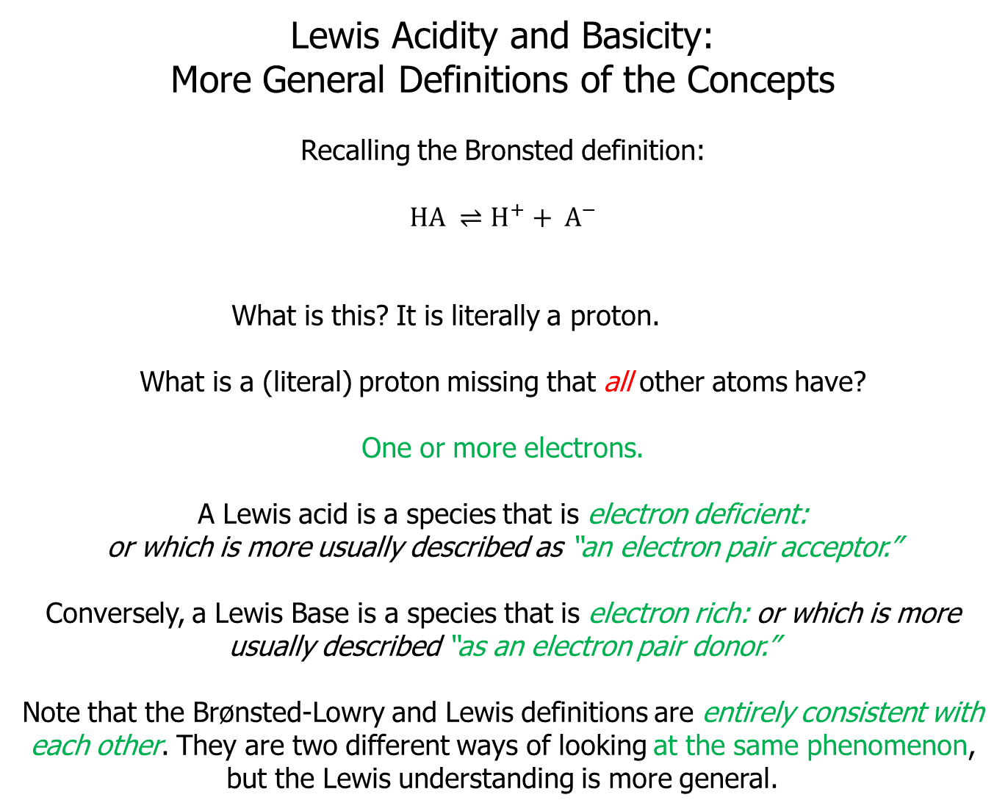
Lewis Acidity and Basicity:
More General Definitions of the Concepts
Recalling the Bronsted definition:
$$HA ⇌H^{+}+ A^{−}$$
What is this? It is literally a proton.
What is a (literal) proton missing that all other atoms have?
One or more electrons.
A Lewis acid is a species that is electron deficient:
or which is more usually described as “an electron pair acceptor.”
Conversely, a Lewis Base is a species that is electron rich: or which is more usually described “as an electron pair donor.”
Note that the Brønsted-Lowry and Lewis definitions are entirely consistent with each other. They are two different ways of looking at the same phenomenon, but the Lewis understanding is more general.

Slide 20
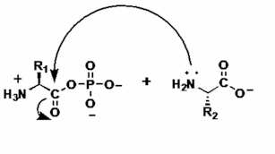
Why Lewis Acids and Bases?
The concepts of Lewis acidity and basicity provide a framework for understanding much of organic chemical reactivity.
Consider the peptide bond formation that takes place on the ribosome.
The amino group of the last amino acid added to the growing peptide chain bears a lone pair of electrons, circled in blue.
This means that it is electron rich, one of the definitions of a Lewis base.
The carbonyl carbon of the acylphosphate group on the incoming amino acid, circled in red, is highly activated, as in ‘primed to react.’
Involved in a double bond to oxygen and attached to the strongly electron-withdrawing phosphate group, this carbon is very electron-deficient. It is a Lewis acid.

